Slide 1


Team Rocket
Devon, Shayan, Sebastian, Lupe, Sharon

Slide 2
Application Domain
Plan-it creates an activity plan for users that will fit their time and budget.
If users dislike the plan, they can simply generate a new one.
Motivation for this project:
Having free time but not knowing how to spend it
Having to stick to a budget and wanting to know different options

Slide 3
Goals
Allow users to generate a plan given time and cost
Let users add and edit activities to the database
Let users specify the following attributes for each activity:
Activity name
Max time - max amount of time activity could last
Ideal time - how long activity should last
Max cost - max expected cost of activity
Activity type (food, games, outdoor, fitness, music, etc)
Allow users to save their plan as a PDF

Slide 4
Challenges:
Learning how to use new technologies and APIs
Avoiding merge conflicts when using github
Accomplishments:
Successfully able to generate a random plan that will be able to take to your time and money into consideration
Successfully converted project into a maven project - this allowed for the use of many useful APIs. Example - importing the iText feature to save a plan as a pdf. Importing jUnit testing to easily create and run tests.

Slide 5
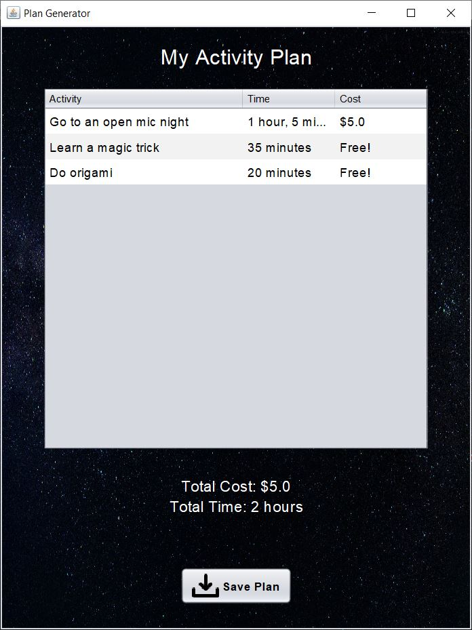
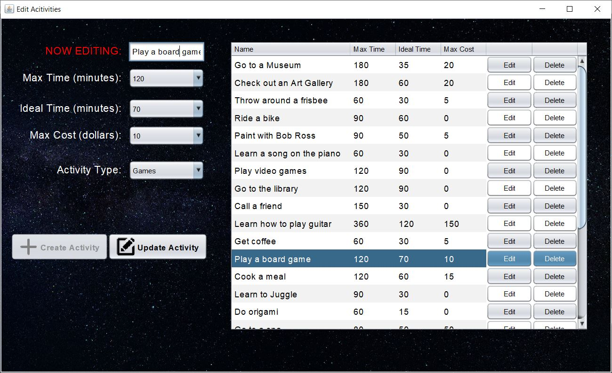
Screenshots (backup if live demo doesn’t work)

Slide 6
Technologies Used
Java
Git/Github
Maven
Clubhouse
Graphic libraries: Java awt and swing
MySQL
iText API
Junit Test
Jenkins

Slide 7
Project Management Techniques
Practiced Scrum
Used Clubhouse to assign and keep track of tasks for each sprint (virtual scrum board)
Met three times a week
Communicated via text group chat
Used GitHub for version control
Used Jenkins for Continuous Integration

Slide 8
What we enjoyed:
Successfully implementing new technologies
Seeing the project come together
Learning how to use tools to make implementing new features more manageable
What we didn’t enjoy:
Coming across unexpected bugs
Realizing the need of new technologies (e.g: Maven file for dependencies, iText for pdf generator, MySQL for our database)
Keeping in mind that Java runs differently on different operating systems

Slide 9
What worked:
Meeting at scheduled times for Scrum meetings
Communicating via group chat
Constantly pulling from GitHub repo
What didn’t work:
Assigning tasks through spreadsheets (stopped after sprint 1)
Things we wish we had done:
Started documenting our tests earlier
Learn of ClubHouse earlier

